Slide 1
AI Prompt Generation for Educational Content

Slide 2
Introduction
Introduction to AI prompt generation for educational content.
Overview of how AI can assist faculty in creating high-quality instructional materials efficiently.
Importance of iterative refinement in prompt generation.

Slide 3
Why Refinement Matters
Importance of clarity, precision, relevance, and creativity in prompts.
Adaptability in refining prompts for better AI output.

Slide 4
Course Example
Course: “Introduction to Environmental Science”
Task: Creating a focused study guide on climate change using Copilot

Slide 5
Copilot Resource
Use Microsoft Copilot - CTLD Ready (msudenver.edu)

Slide 6
Prompt Engineering
What makes a good prompt?

Slide 7
Key Elements to Include
Content Type | Tone and Style
Subject Matter | Length and Format
Objective or Purpose | Special Requirements
Target Audience

Slide 8
Example
'Generate a comprehensive lecture on the subject of climate change. Cover key concepts, historical developments, current applications, and future trends. Include discussions on the ethical considerations and challenges associated with climate change.'"

Slide 9
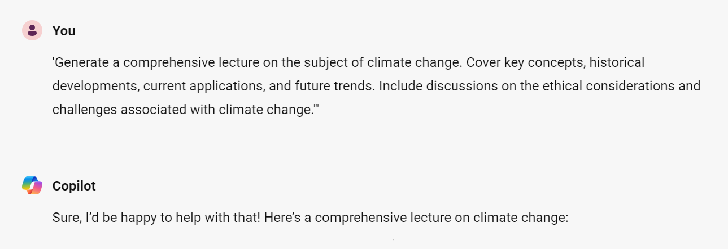
Example

Slide 10
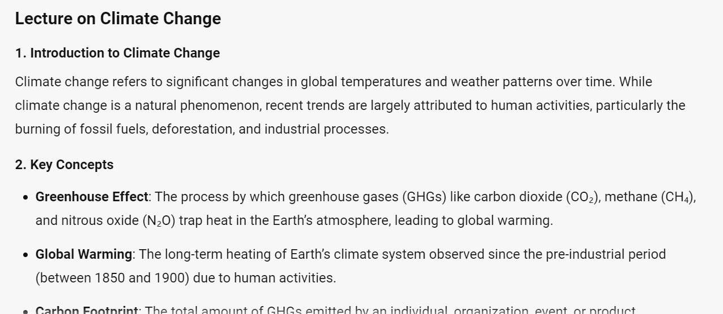
Example

Slide 11
Let’s walk through it together!

Slide 12
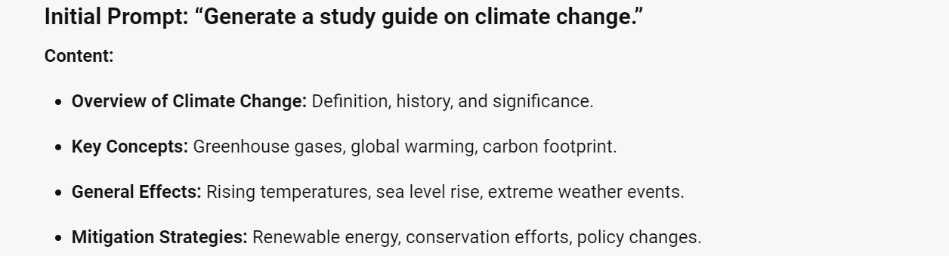
Initial Prompt

Slide 13
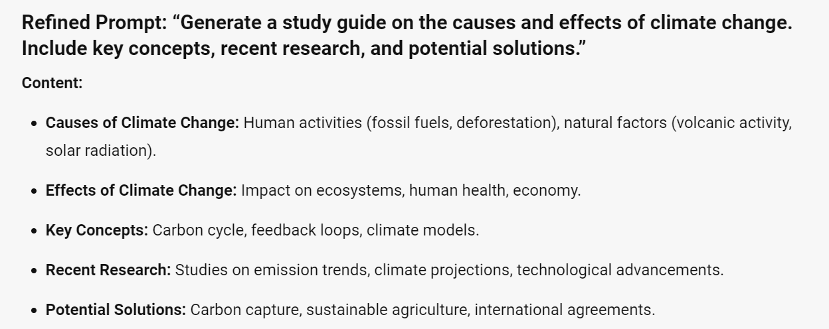
2nd Iteration: Refined Prompt

Slide 14
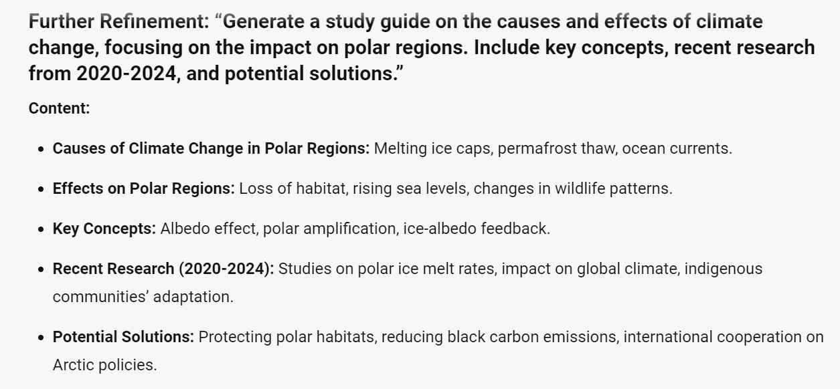
3rd Iteration: Further Refinement

Slide 15
Additional Resources to Include
Examples of previous study guides
Transcript of a previous lecture
Specific, related keywords
More questions?
Generative AI Archives - CTLD Ready (msudenver.edu)

Slide 16
Thank You for Watching!
Virtual Drop-In Support:
ready.msudenver.edu/immediate-support
Physical Drop-in Support:
AD 325 (Mon-Fri, 10am-3pm)
Email:
ctldsupport@msudenver.edu
Voicemail:
303-615-0801

Slide 17
Produced by the Center for Teaching, Learning and Design: Your Name - Instructional Design Support Specialist Todd Wolfe – Instructional Media & Support manager Alex McDaniel - Associate Director of Instructional Design
With photography by:
Photographer (Image Hosting Site) - URL
Photographer (Image Hosting Site) - URL
Photographer (Image Hosting Site) - URL
Photographer (Image Hosting Site) - URL
Photographer (Image Hosting Site) - URL

